Slide 1

Insights for the medical imaging market
Webinar
COVID-19 Business Impact
on Medical Imaging
April 29, 2020
covid19@imvinfo.com
© 2018 IMV, part of the Science and Medicine Group
© 2020 IMV, part of Science and Medicine Group
IMV
671 North Glebe Road
Suite 1610
Arlington, VA 22203
www.imvinfo.com
IMV
671 North Glebe Road
Suite 1610
Arlington, VA 22203
www.imvinfo.com

Slide 2


Today’s Presenters
Lorna Young
Sr Director Insights
Craig Overpeck
CEO

Slide 3





Our Global Insights Brands are Leaders in
Instrumentation, Life Science, Imaging, and Clinical Diagnostics

Slide 4


Imaging Tracker Methodology
Survey conducted in US and EU
every other week
Survey available to respondents for one week, each wave
Data included in Tableau file with filters by key demographics

Slide 5
Demographics

Slide 6
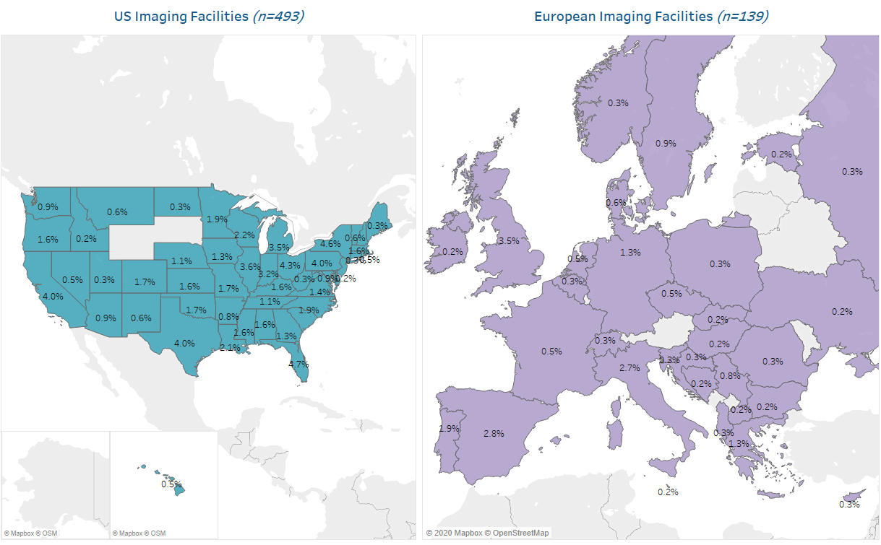
Regional Distribution
US n=493, Europe n=139 (Wave 1)

Slide 7
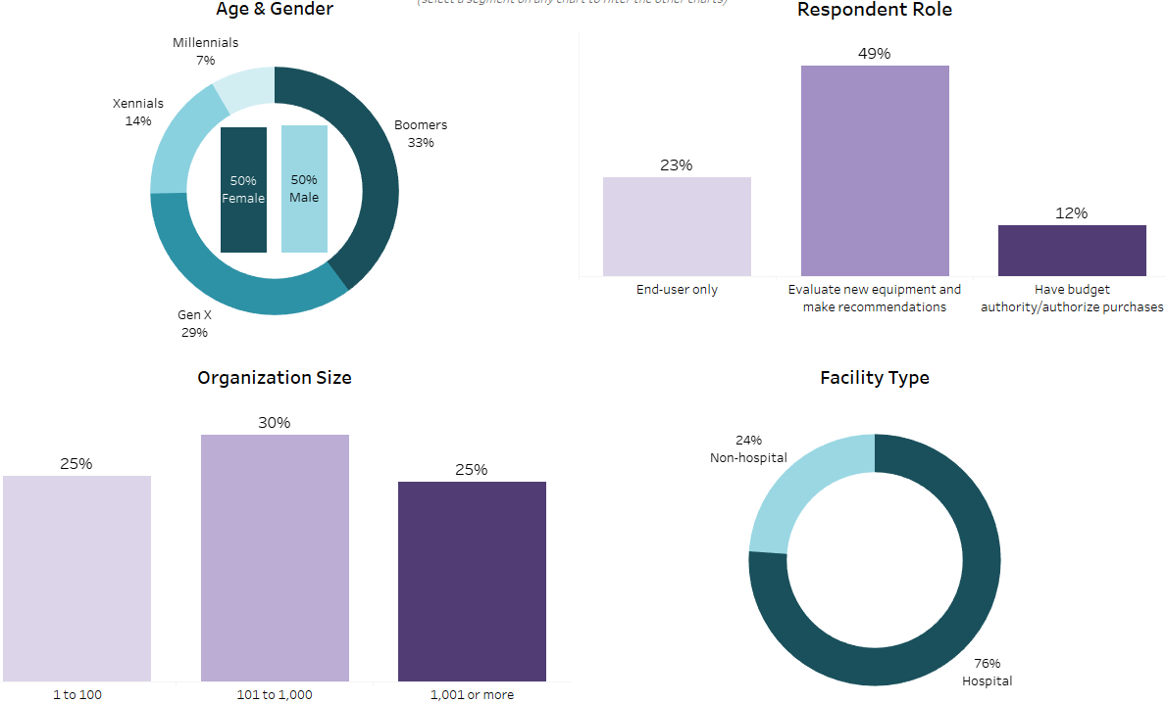
Additional Demographics – Available Filters in Report
n= 632 (Wave 1)

Slide 8
Department Disruption

Slide 9

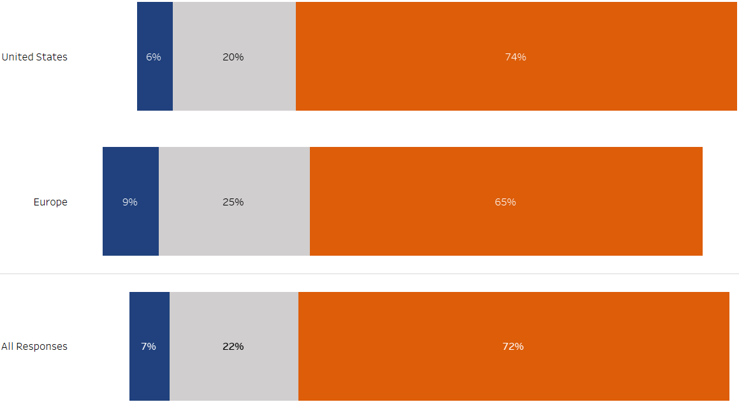
COVID-19 having Significant Impact
Overall Impact of COVID-19 Pandemic on Department
US n=493, Europe n=139, All n=632 (Wave 1)
How much of an IMPACT is the current coronavirus pandemic having on your department? (choose only one)

Slide 10
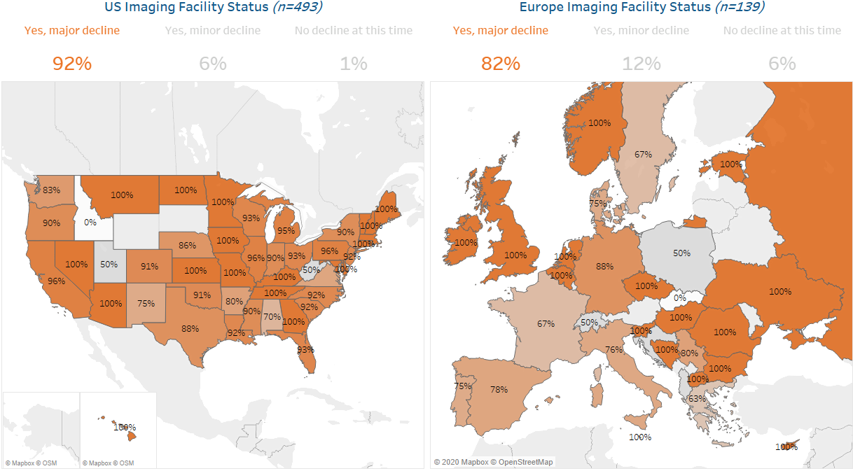
Impact on Imaging Facilities (4/10/20-4/27/20)
US n=493, Europe n=139 (Wave 1)
Is your department experiencing a decline in non-coronavirus procedure volume due to COVID-19?

Slide 11
Impact by Modality

Slide 12
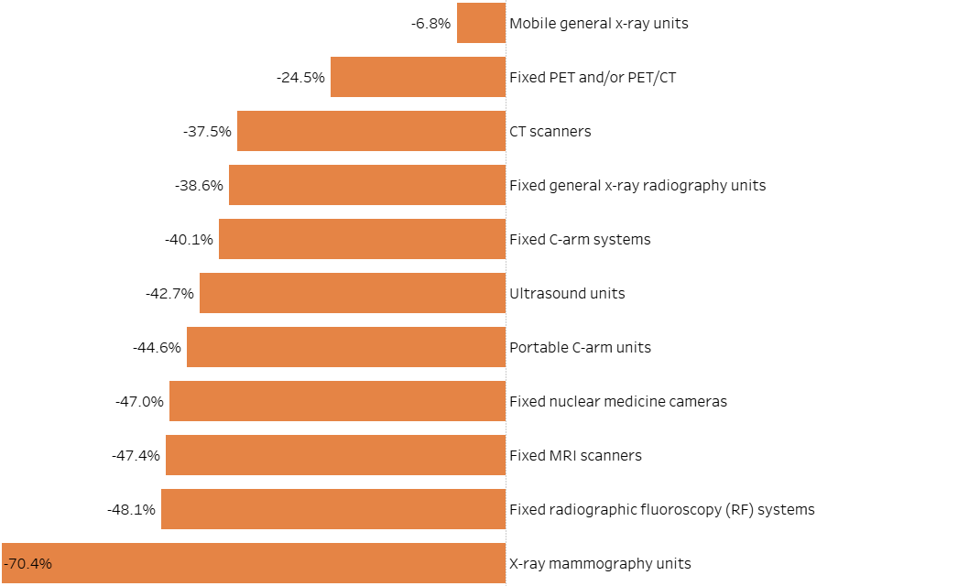
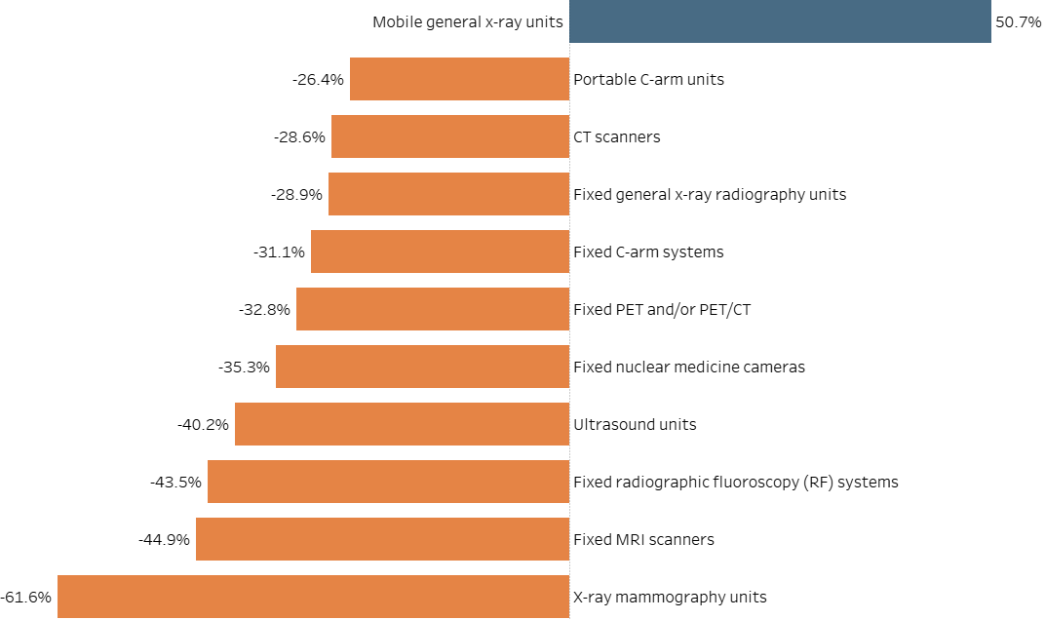
Mobile general x-ray units are being deployed for coronavirus-related diagnosis, particularly in Europe
CT being used for COVID patients has smaller decline than elective procedures like mammography, which are hit hard
Average Impact on Procedure Volume, by Region
United States
Europe
US n=447, Europe n=105 (Wave 1)
For each of the following tests/modalities how has your procedure volume been impacted due to coronavirus? (choose one for each)

Slide 13
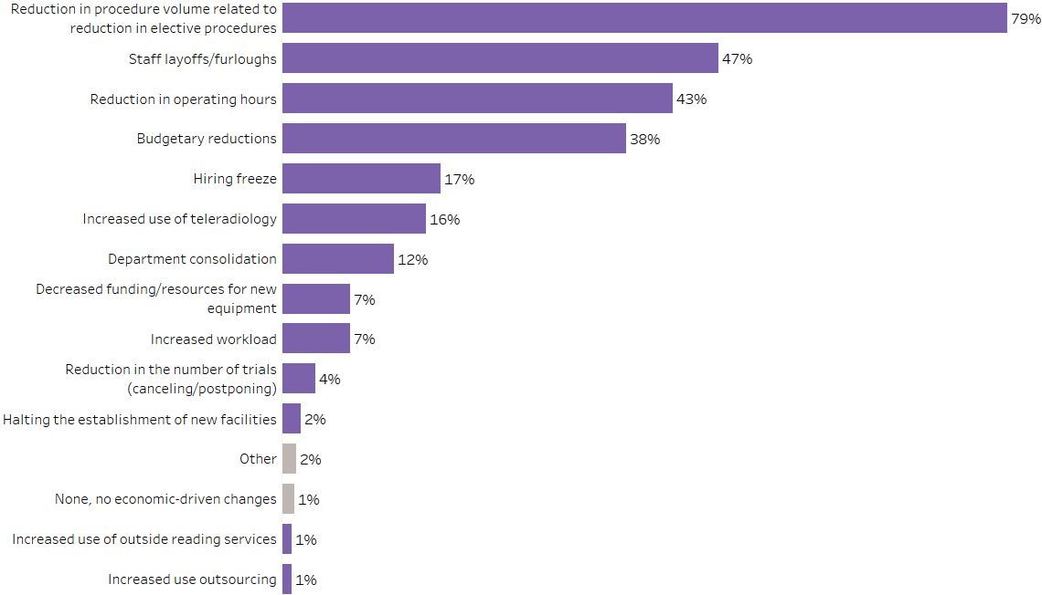
Procedure volume directly impacts staffing, hours, budgets
Top Economic-Driven Changes in Organization
n= 632 (Wave 1)
What are the top THREE economic-driven changes currently happening at your organization/institution? (check up to three)

Slide 14
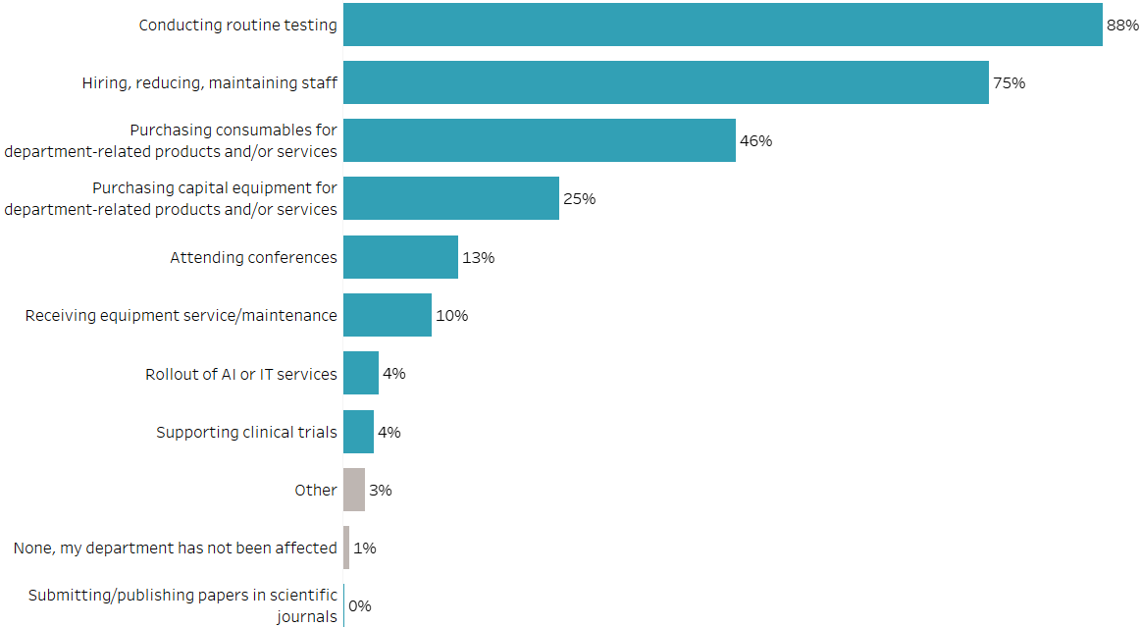
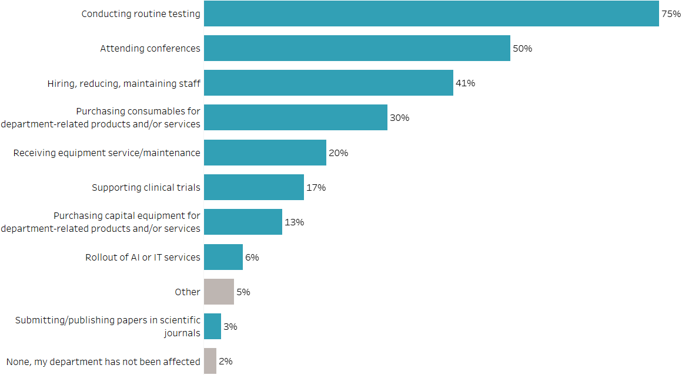
Routine Testing, Staffing, Conferences Affected
Areas Most Affected by Current Pandemic and Economic Climate, by Region
United States
Europe
US n=493, Europe n=139 (Wave 1)
In your department, what THREE areas are most affected by the current pandemic and economic climate? (check no more than three)

Slide 15
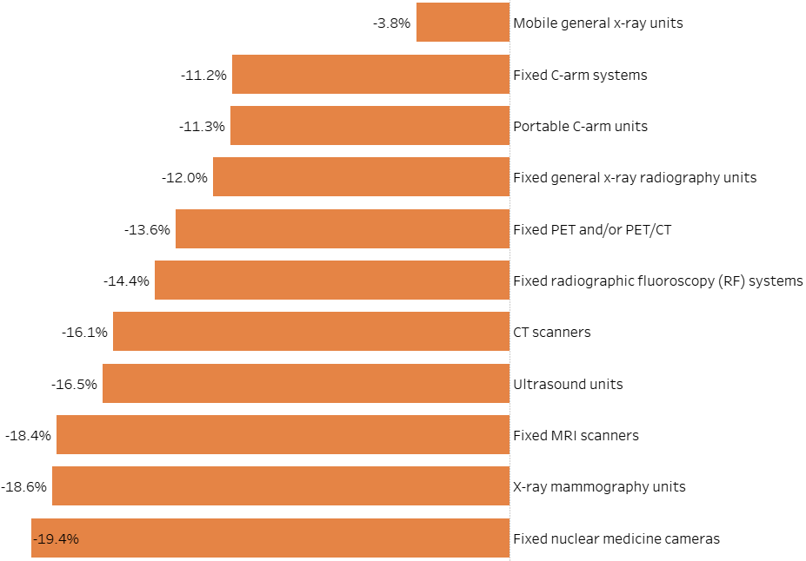
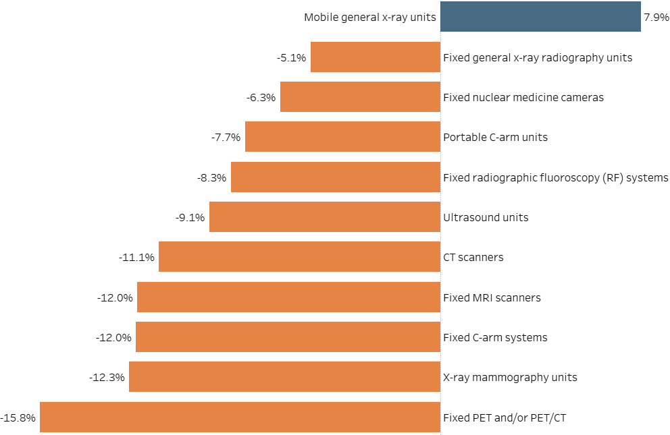
Budget Impact for 2020 by Equipment Modality
Average Change in Spending on Products in 2020, by Region
United States
Europe
Compared to your annual budget, how do you expect the average amount of money that your department spends on products purchased in each of the following categories to change in 2020? (choose only one or each)
US n=355, Europe n=72 (Wave 1)

Slide 16
How long until we get back to normal?

Slide 17
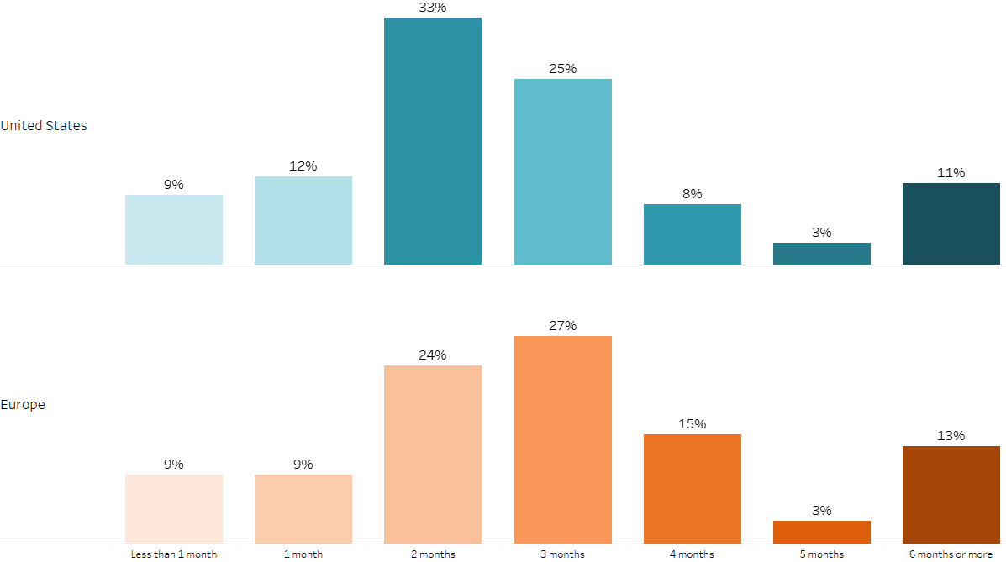
The majority currently feel it will take 2-3 months to ramp up
Anticipated Time for Department to Ramp Up to Previous Volume Level, by Region
US n=488, Europe n=131 (Wave 1)
How long do you anticipate that it will take your department to ramp back-up to previous volume levels? (choose only one)

Slide 18
Questions?
Q&A

Slide 19
Please email COVID19@IMVInfo.com to receive the slide deck or for information about how to purchase the ongoing tracking data
THANK YOU

